Slide 1
Week 8
QA Automation Course

Slide 2
Homework review

Slide 3
What we’ll do today
WebElement methods
Demo: how to create a project from scratch
? Regexes

Slide 4
WebElement methods
IWebElement myElement = driver.FindElement(By.ClassName("map-search"));
myElement.Click();
* http://seleniumhq.github.io/selenium/docs/api/dotnet/?topic=html/T_OpenQA_Selenium_IWebElement.htm

Slide 5
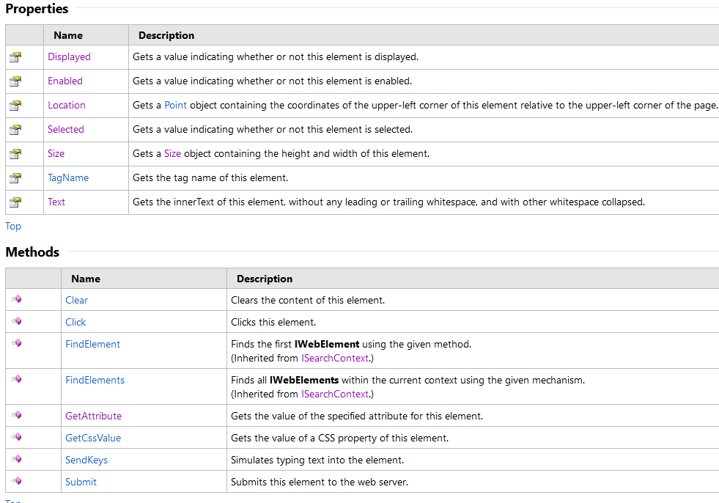
WebElement methods (2)
* http://seleniumhq.github.io/selenium/docs/api/dotnet/?topic=html/T_OpenQA_Selenium_IWebElement.htm

Slide 6
Demo
Project
C#
Chrome
WebDriver
IE
Variables
Classes
String, int
IWebDriver
IWebElement
new ChromeDriver();
findElement()
CSSSelector
chromedriver.exe
IEDrivgeckodriver.exe
geckodriver.exe
FF
…
Nunit
[TestFixsture] [Test] [SetUp] [TearDown] Assert;

Slide 7
Demo
How to setup a project from scratch
Preconditions
Visual Studio installed
Nunit GUI installed if you want to run tests in GUI
Install latest NuGet package Manager version?
https://marketplace.visualstudio.com/items?itemName=NuGetTeam.NuGetPackageManagerforVisualStudio2013
Create new solution (it contains 1 project as a start)
Add Nunit
Add WebDriver

Slide 8
What Automation testing does
To make sure Software product today works the way it worked yesterday regarding the tested functionalities
Feature is OK
Test Passes
Feature is OK
Test Fails
Feature is NOK
Test Passes
Feature is NOK
Test Fails

Slide 9
Regexes (tentative)
What is a regex
regular expression, regex or regexp[1] is, in theoretical computer science and formal language theory, a sequence of characters that define a search pattern. * from Wikipedia
C# Regexes (.Net): https://msdn.microsoft.com/en-us/library/az24scfc(v=vs.110).aspx

Slide 10
Regexes (2)
Boolean "or"
A vertical bar separates alternatives. For example, gray|grey can match "gray" or "grey".
Grouping
Parentheses are used to define the scope and precedence of the operators (among other uses). For example, gray|grey and gr(a|e)y are equivalent patterns which both describe the set of "gray" or "grey".
Quantification
A quantifier after a token (such as a character) or group specifies how often that preceding element is allowed to occur. The most common quantifiers are the question mark ?, the asterisk * (derived from the Kleene star), and the plus sign + (Kleene plus).
?
The question mark indicates zero or one occurrences of the preceding element. For example, colou?r matches both "color" and "colour".

Slide 11
Regexes (3)
*
The asterisk indicates zero or more occurrences of the preceding element. For example, ab*c matches "ac", "abc", "abbc", "abbbc", and so on.
+
The plus sign indicates one or more occurrences of the preceding element. For example, ab+c matches "abc", "abbc", "abbbc", and so on, but not "ac".
{n} {min,} {min,max}
The preceding item is matched exactly n times.
^
Matches the starting position within the string. In line-based tools, it matches the starting position of any line.
[]
A bracket expression. Matches a single character that is contained within the brackets. For example, [abc] matches "a", "b", or "c". [a-z] specifies a range which matches any lowercase letter from "a" to "z". These forms can be mixed: [abcx-z] matches "a", "b", "c", "x", "y", or "z", as does [a-cx-z].
*All examples are from Wikipedia
https://en.wikipedia.org/wiki/Regular_expression

Slide 12
Regexes (4)
Why Regexes are useful
Date fields
Phone fields
URL checks
A LOT MORE
http://regexr.com/ - practice and examples

Slide 13
Regexes (5)
How to use them in C# tests
Assert.That("abbbbbcde", Does.Match("ab*cde"));
Assert.That("acde", Does.Match("ab*cde"));
<title>Тристаен апартамент в София 93 кв.м. ID 69276 | Явлена</title>
Assert.That(driver.Title, Does.Match(".* ID [0-9]{5} \\| Явлена"));
StringAssert.IsMatch(".* ID [0-9]{5} \\| Явлена", driver.Title);

Slide 14
Homework
IWebElement homework???
Optional homework (on Regexes):
Regex homework 1
Open https://yavlenawebsite.melontech.com/broker/
Click on the first broker on the page
Use regex to check that the URL of the newly opened page (broker page) is correct.
Note that the first broker can change over time, so the check should not rely that one and the same broker is at first position.
Regex homework 2
Open https://yavlenawebsite.melontech.com/broker/
For each broker check that there are 2 phone numbers present – first one is a landline, second one is mobile. Use regexes too verify phone numbers are displayed in correct format.

Slide 15
Q & A

Slide 16
Sources:
1. http://seleniumhq.github.io/selenium/docs/api/dotnet/?topic=html/T_OpenQA_Selenium_IWebElement.htm

